Slide 1
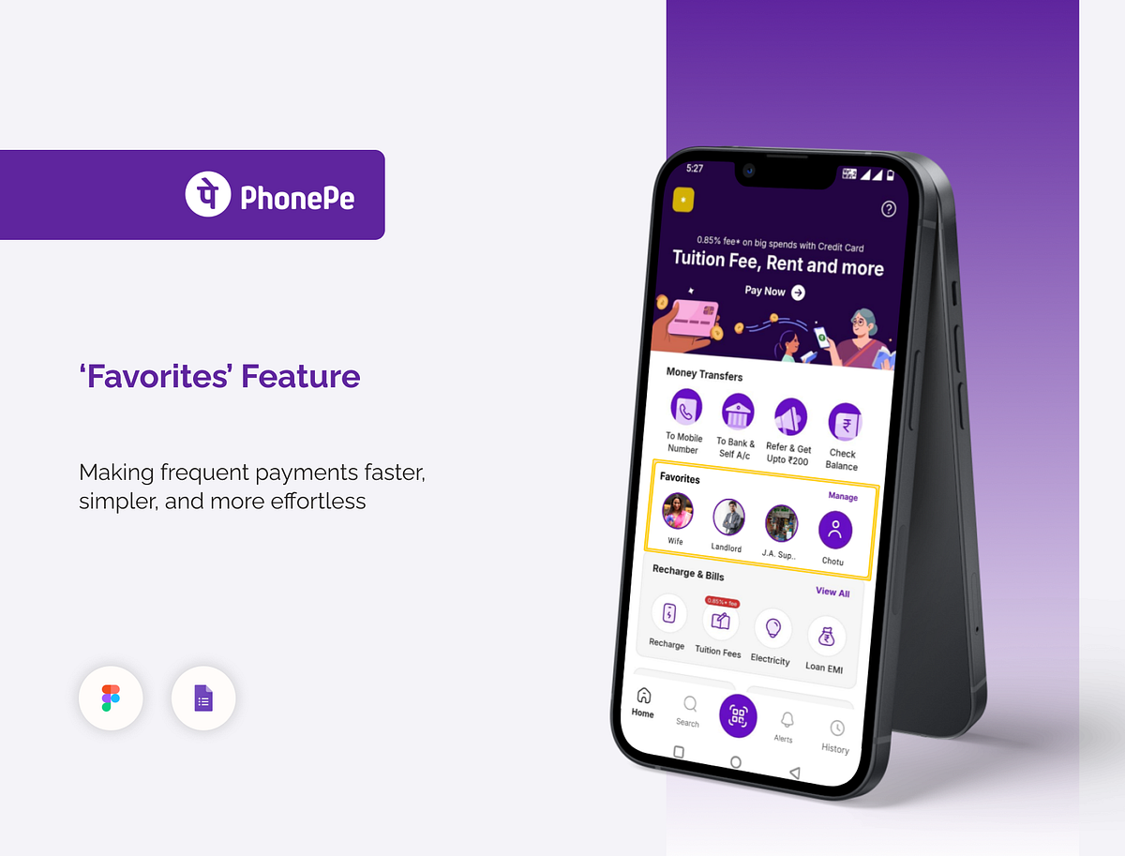
PhonePe Digital Payments
Analysing Transaction and Demographic Data across India — 2018 through Q2 2021
BUSINESS INTELLIGENCE CASE STUDY
POWER BI DASHBOARD ANALYSIS

Slide 2
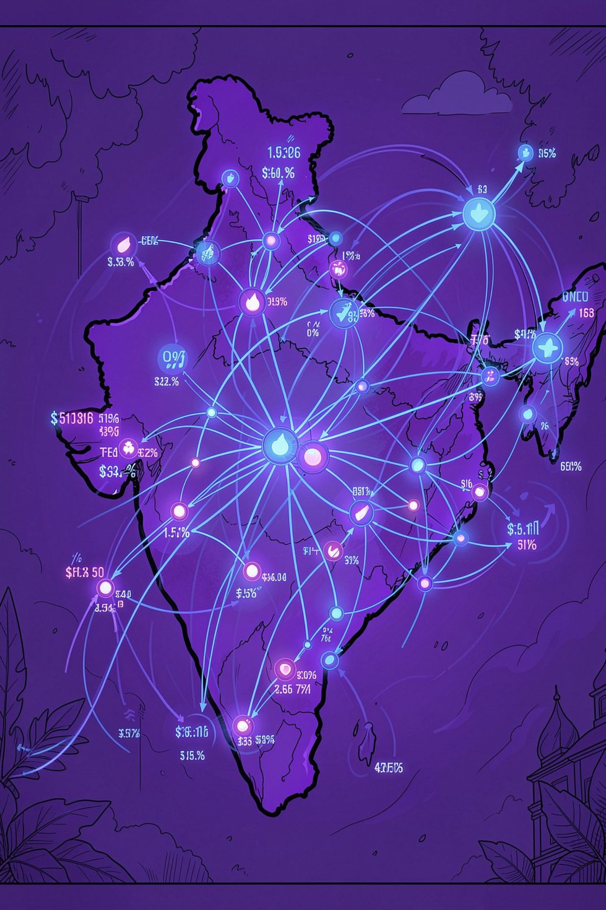
Macro Highlights at a Glance
20.53B
Transactions
Cumulative volume recorded nationally
₹36T
Gross Transaction Value
₹35.87–₹36.30 Trillion circulating through the platform
36
States / UTs
Spanning 731 active administrative districts
₹14.9K
Per User Value
Cumulative transaction value per registered user
National Average Transaction Value (ATV) expanded from ₹1,502 in 2018 to a peak of ₹1,836 in 2020, stabilising around ₹1,802 in 2021 as retail micro-payments gained momentum.

Slide 3

Dataset Overview
State_Txn & Users
State-level transactions, amounts, registered users, and app opens
State_TxnSplit
Breakdown by transaction type — P2P, Merchant, Recharge & Utilities
State_DeviceData
Device brand distribution and user percentages per state
District_Txn & Users
Granular district-level transaction and user metrics
District Demographics
Population, area, density, and district headquarters

Slide 4
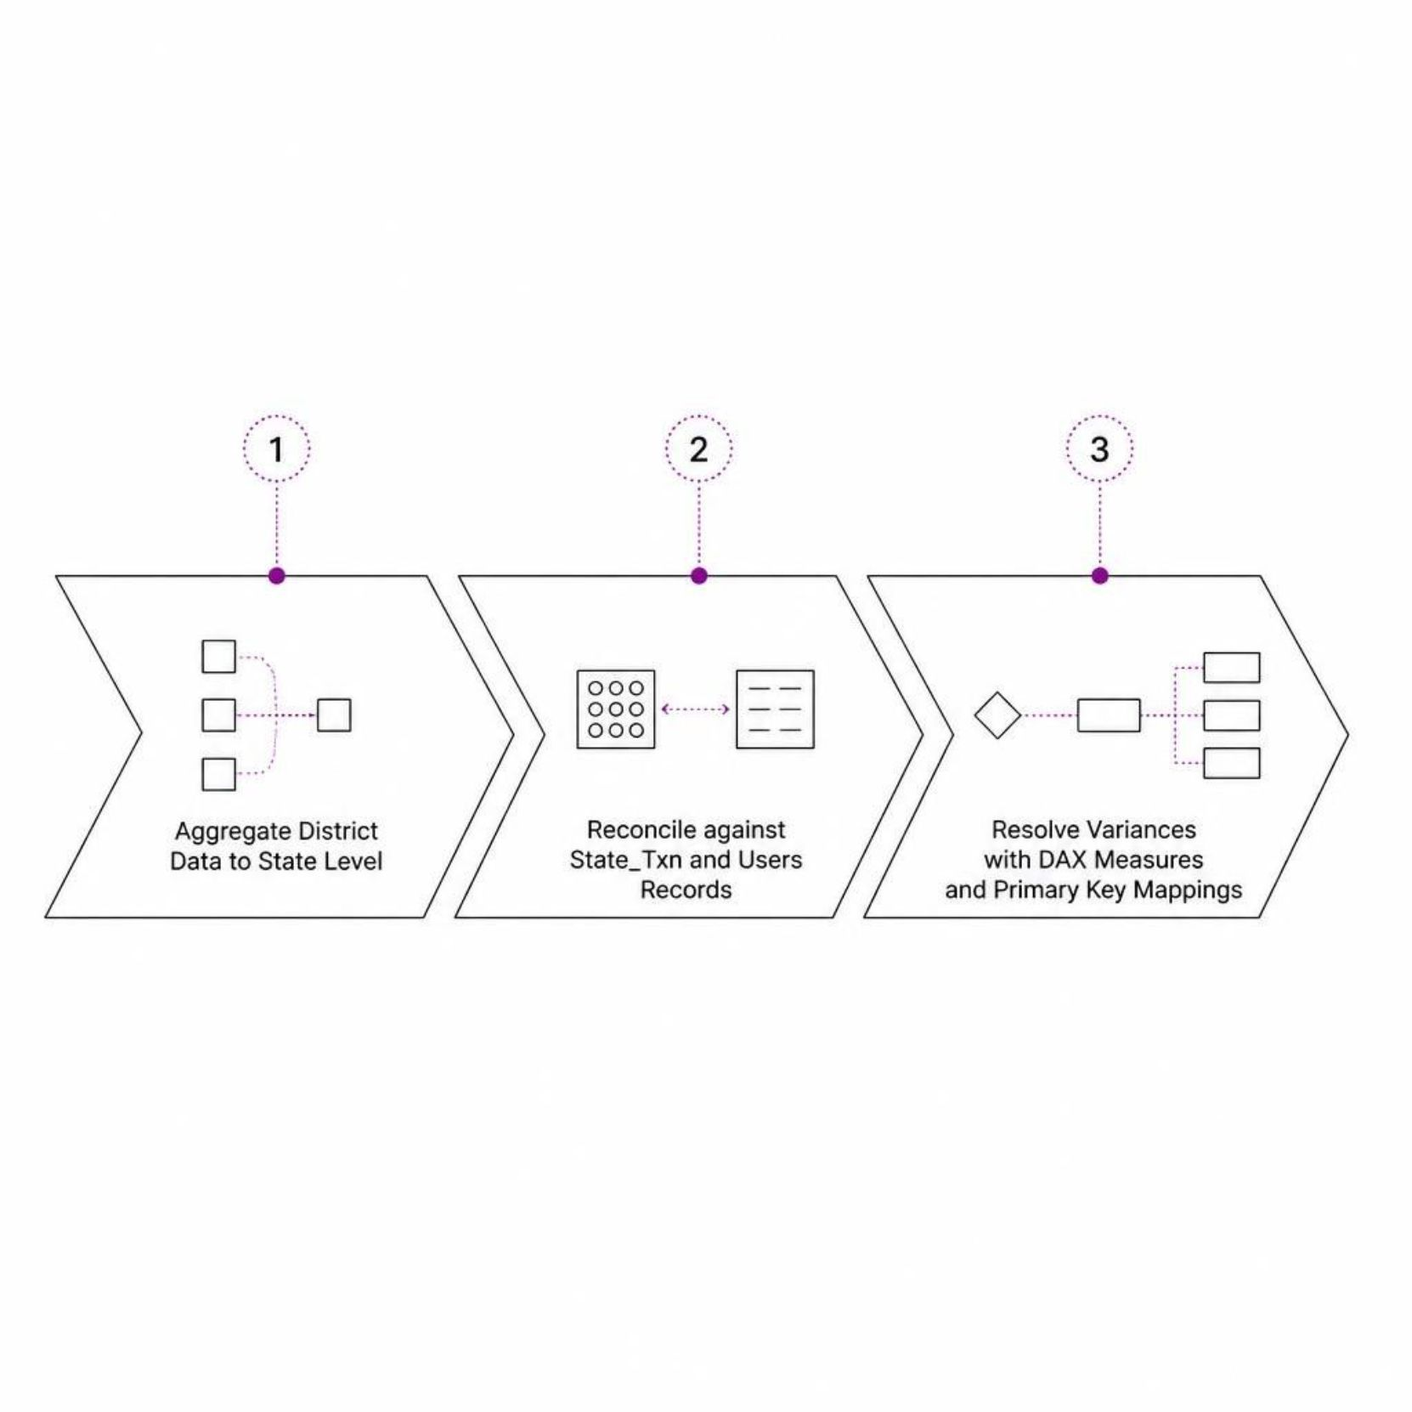

Data Integrity & Consistency Audit
Validation Methodology
District-level metrics (Transactions, Amount, Registered Users) were aggregated to state level and reconciled against State_Txn and Users records.
99.9% consistency achieved across all states. One variance in Andhra Pradesh (Total Amount) was resolved using weighted DAX measures and District Code mappings.
Telemetry Note: App Opens show 0 from Q1-2018 to Q2-2019 — user session telemetry was formally integrated into the PhonePe repository starting Q3-2019.

Slide 5
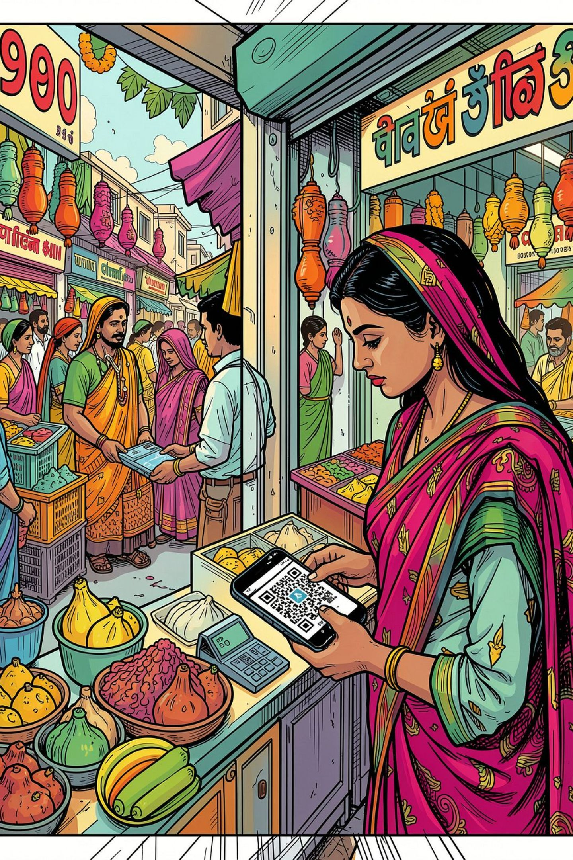
Payment Channel Dynamics
Peer-to-Peer (P2P)
Merchant Payments (QR)
44.62% of volume (9B txns) and over 84% of total monetary value — backbone for high-value family transfers
33.89% of volume (7B txns) — widespread offline QR code penetration
Recharge & Utilities
20.68% of volume (4B txns) — declined from ~50% of traffic in 2018
By 2021, P2P and Merchant payments commanded over 80% of total system volume — the ecosystem transitioned into an everyday lifestyle payment utility.

Slide 6
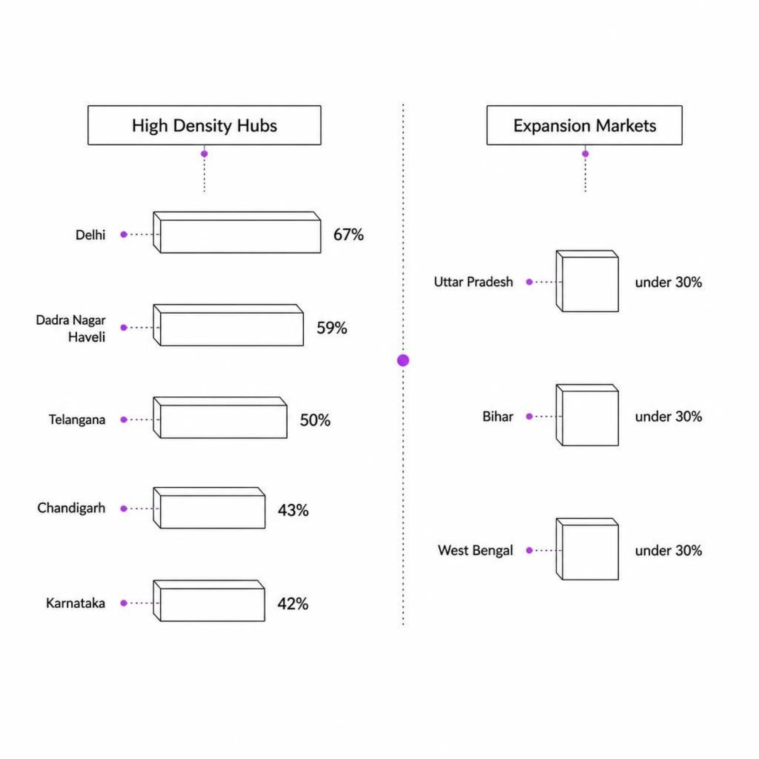
Regional Market Concentration & User Adoption
Top Volume States
Karnataka, Maharashtra, Telangana, Andhra Pradesh, and Rajasthan collectively account for over 50% of India's digital payment throughput. Activity is heavily concentrated in Southern and Western India.
High Digital Density Hubs
Delhi — 67% user-to-population ratio
Dadra & Nagar Haveli — 59%
Telangana — 50%
Chandigarh — 43%, Karnataka — 42%
High-Upside Expansion Markets
Uttar Pradesh, Bihar, and West Bengal remain under-penetrated (<30% user ratio) — the
next frontier for user acquisition.

Slide 7
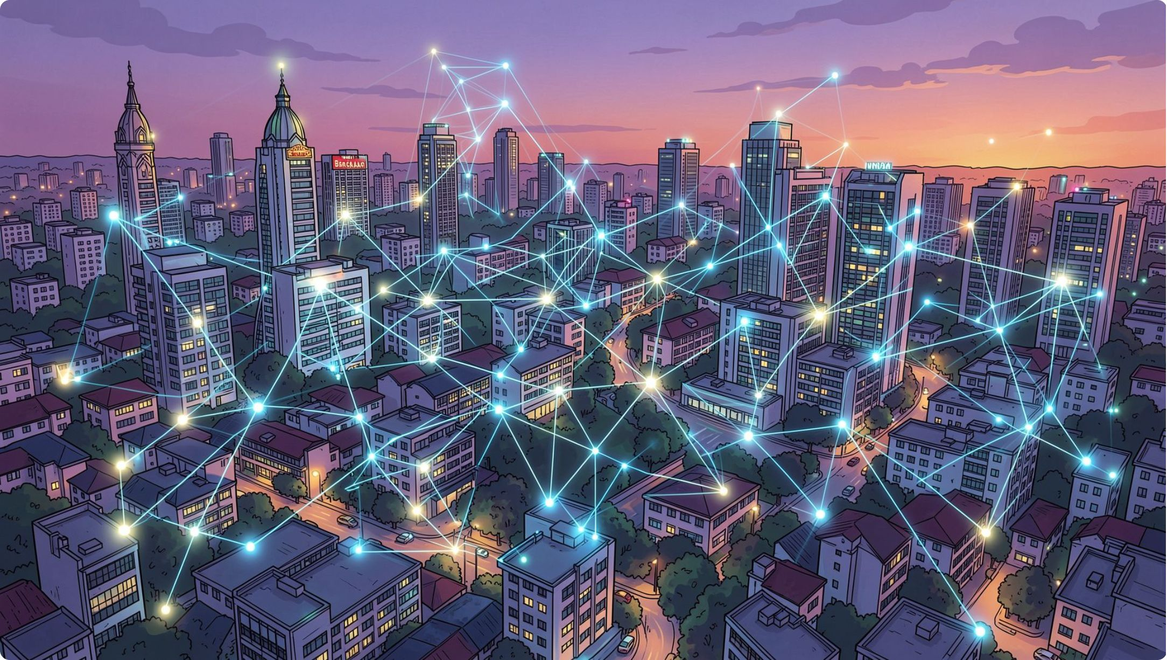
District-Level Insights: Revenue & Ticket-Size
Top Revenue Centres
Bengaluru Urban — ₹2.57 Trillion (national leader)
Hyderabad — ₹1.90T
Pune — ₹1.42T
Jaipur — ₹1.20T
Rangareddy — ₹0.58T
Highest ATV Districts (Outlier Analysis)
Remote and frontier regions lead in average ticket size:
Shi Yomi (Arunachal Pradesh) & Saiha (Mizoram) — ₹4,500–₹5,000+ per transaction
Nicobar, Leh Ladakh, Kargil, East Kameng — averaging ₹3,200–₹4,000+
These regions use digital infrastructure for essential bank remittances and household transfers rather than retail micro-payments.

Slide 8
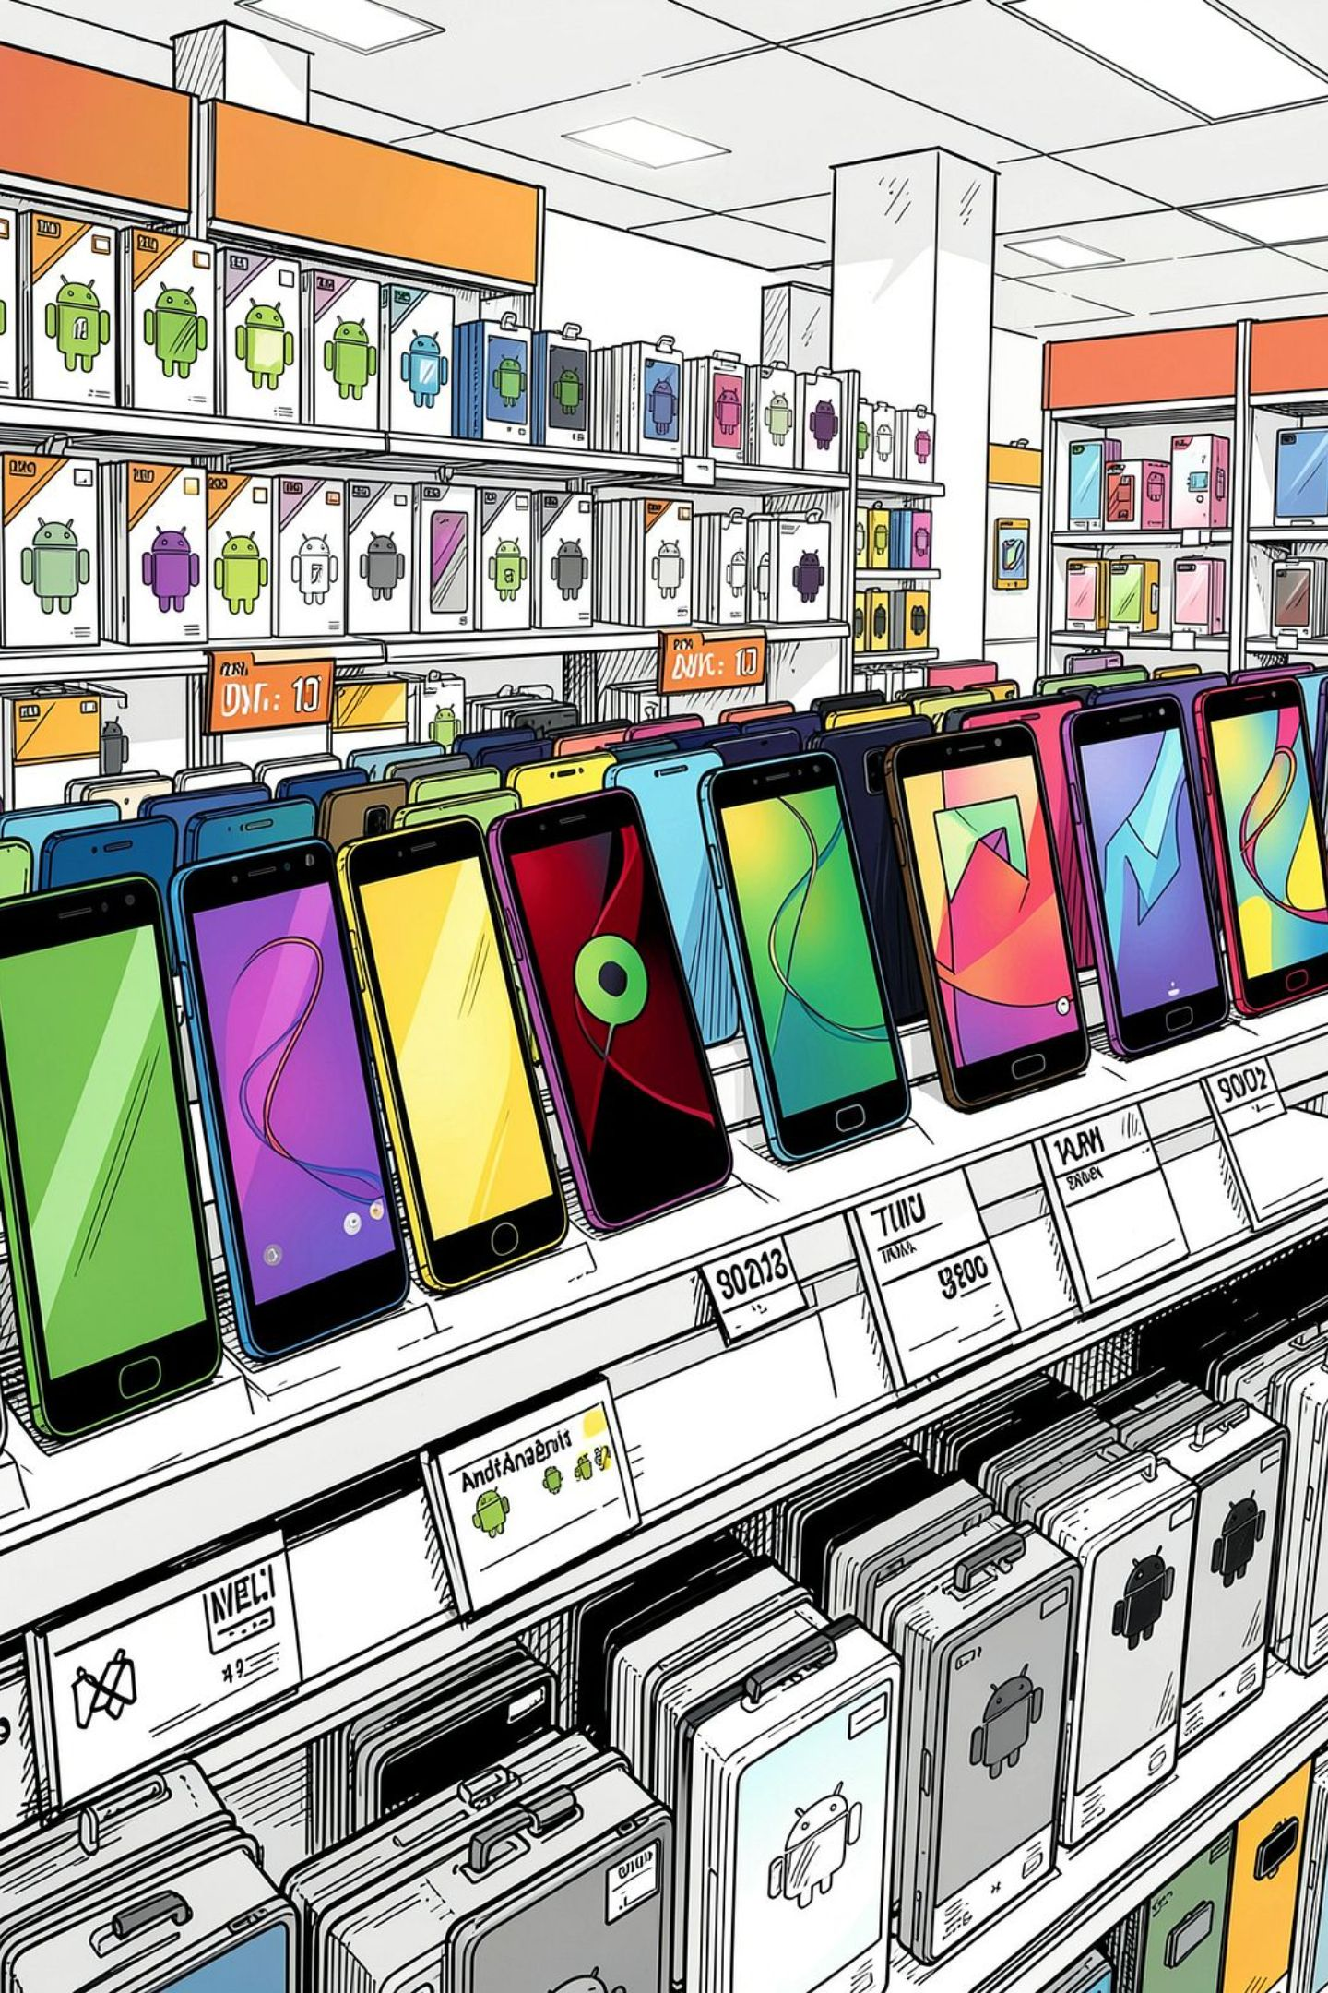
Hardware OEM Ecosystem Dominance
616M
Xiaomi
Unchallenged #1 — leads 35 of 36 states/UTs
481M
Samsung
Second tier; leads only in Sikkim
411M
Vivo
Third in cumulative user instances
284M
Oppo
Fourth in the adoption hierarchy
Budget and mid-range Android devices drive over 85% of PhonePe's installed base. Xiaomi's dominance underscores the importance of value-tier smartphone partnerships for user acquisition.

Slide 9
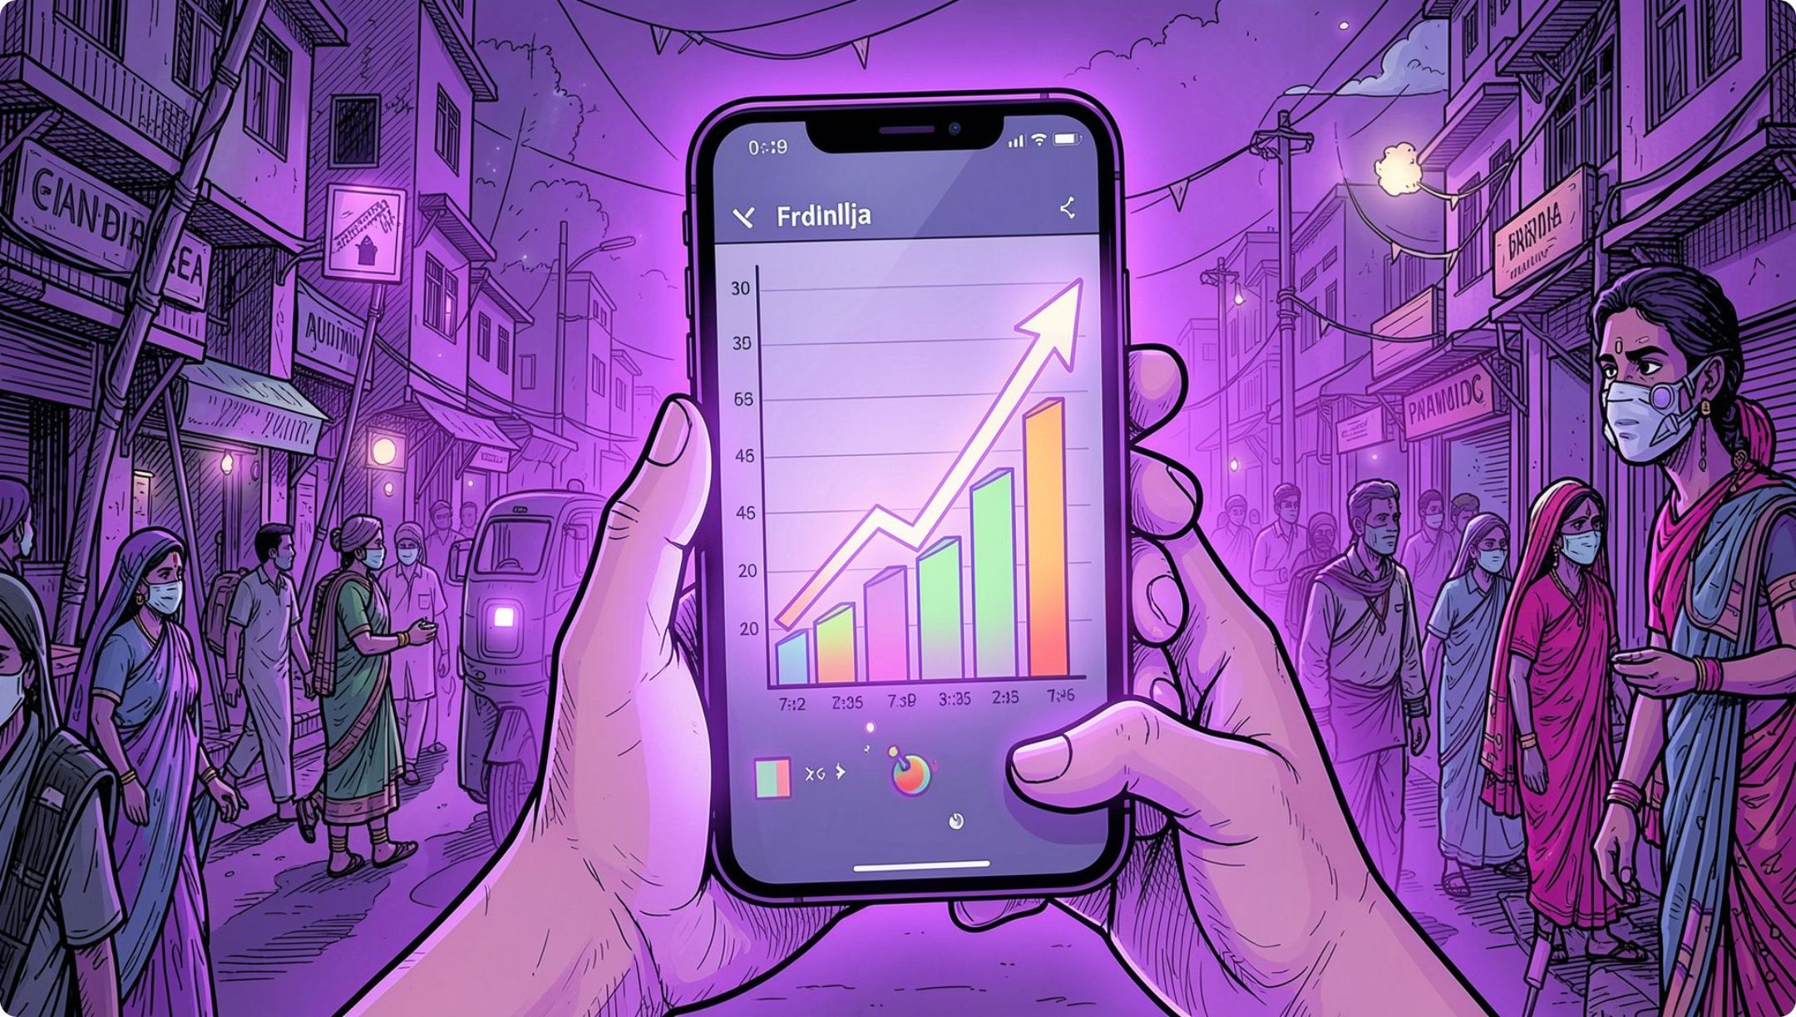
Temporal Trends & Inflection Points
COVID-19 Inflection Surge (Q2-2020)
Following national pandemic restrictions, quarterly transactions and app opens experienced an exponential trajectory. In Maharashtra, quarterly app opens accelerated to 1.21 Billion by Q2-2021.
Maturation of Platform Trust
National ATV expanded from ₹1,502 (2018) to ₹1,836 (2020) — reflecting rising consumer trust as users moved beyond small promotional recharges to high-value transfers, mutual fund investments, and gold purchases.

Slide 10
Strategic Recommendations
1
2
High-ATV Financial Products
Merchant Ecosystem Monetisation
Deploy domestic remittances, fixed savings, and insurance bundles in districts like Shi Yomi, Saiha, and Kargil where ticket sizes exceed ₹3,500–₹5,000+
Accelerate Smart Speaker soundbox rentals, POS financing, and working capital micro-loans — QR codes already drive 33.89% of all transactions
3
4
Regional Expansion Campaigns
OEM Strategic Partnerships
Launch localised vernacular onboarding in Uttar Pradesh, Bihar, and West Bengal to convert high population into active transaction volume
Deepen pre-installation and app optimisation tie-ups with Xiaomi and BBK Electronics (Vivo/Oppo/Realme) to secure the primary mobile gateway for new users

